Slide 1


Forecasting Inflation Rate & Determining How it relates to Per-Capita GDP
TEAM-6:
Sai Akhilesh Veldi- 1002079415
Dilip Kumar Allu -1002086509
K Teja Sambasivarao-1002078603
Kakularapu Sreeja Reddy- 1002072005
Venkata Sai Manikanta Reddy Yaradla-1002007074

Slide 2




Index:
Project Charter
Model Selection
Predictive Model analysis
Conclusions and Recommendations

Slide 3
Project Charter:
Project Name: Forecasting inflation rate and determining how it relates to per-capita GDP​ | Champion:​
Business or Process Owner: ​NA | Project Leader: Kurma Teja Sambasiva rao​
Problem Statement: Forecasting inflation rate and determining how it relates to per-capita GDP​ ​ ​ | Project Goal: The Goal of this project is to Forecast the Inflation rate and key attributes that affect it, Then To find the pattern or relation between per-capita Gdp, seeing if the inflation rate alters depending on a country’s per-capita and it’s financial status.​
Business Case: Today, inflation plays a major role in economic crisis, the current inflation rate in the states is 8.62%, In the long term it might increase. The forecasted result will assist organizations, Business owners in budgeting for future Quarters, thereby planning Business strategies to combat inflation.​ | Project Scope: The objective of this project is to Forecast and analyze the data involving the past Inflation rates, Validate the factors that affect it, provide a meaningful insight about the relation between inflation rate and per-capita GDP.​
Team Members:​ ​ Sai Akhilesh Veldi – 1002079415​ Dilip Kumar Allu – 1002086509​ Kakularapu Sreeja Reddy -1002072005​ Kurma Teja Sambasivarao -1002078603​ Venkata Sai Manikanta Reddy Yaradla- 1002007074​ ​ | Benefits:​ Assists the Business Owners, Organizations to plan combat strategies for future inflation rates.​ Assists Investors to invest according to the future rates, it gives an overview to invest in the bond market or not, so the investors can focus on Portfolio Diversification based on the result.​ Assists banks to make changes in Interest rates based on the forecasted future outcome.​ Assists Consumers on what prices may change in the long term.​

Slide 4
Model Selection M
Linear Regression​:
​
Multiple linear regression is used to estimate the relationship between two or more independent variables and one dependent variable.
Here, the dependent variable is the Inflation rate
Model Selection:

Slide 5
Predictive Model Analysis:
Conclusions and Recommendations
3. Conclusions and Recommendations
We have predicted the ‘Inflation rate’ with help of these following properties 'YEAR', 'Purchasing Power', 'Population(in millions)', 'Current account balance U.S. dollars (Billions of U.S. dollars)','GDP', 'Percapita GDP’.
From our prediction, We have seen that there is a correlation between these variables.
Predictive Model analysis

Slide 6
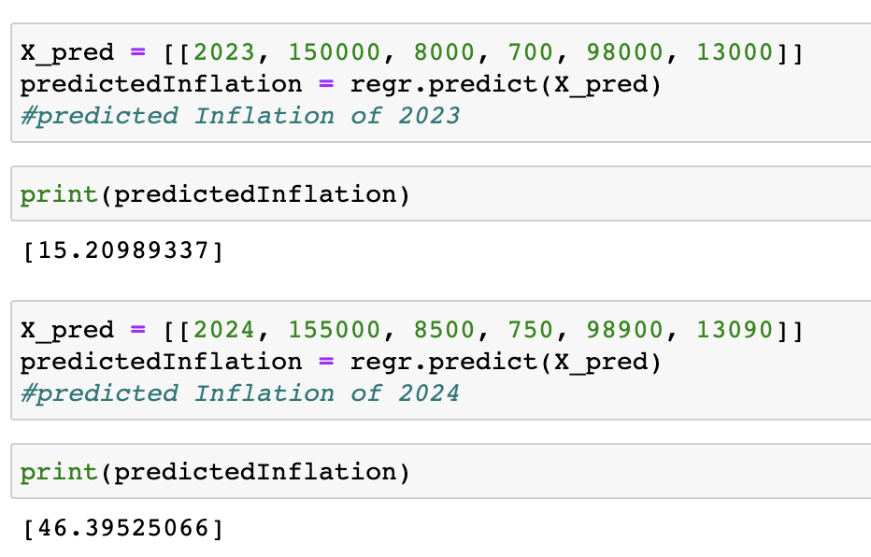
Predictive Model Analysis:
Our model predicts the inflation rate of any year if the dependent variables that we have considered are given to the model

Slide 7
Conclusions & Recommendations.
Hence, We have concluded that apart from characteristics like Population, GDP, Purchasing power, Current account balance. Per-capita GDP play an important role to affect the Inflation rates of any country.

Slide 8
Thank you!

